Slide 1

Key Cryptography
Arbitrary sized input, arbitrary sized output
No data lost (unlike hash functions)
Plaintext to ciphertext and vice versa
Quick to encrypt or decrypt
Not quick to generate keys
Computationally infeasible to guess key

Slide 2
Key Cryptography (symmetric)
Symmetric key cryptography uses one key
Same key used to encrypt and decrypt
Well known: Advanced Encryption Standard (AES)
If Alice sends message to Bob, both need same key (shared secret)
Not very useful for blockchain
still very useful in other contexts, especially message/information sharing (e.g. https)

Slide 3
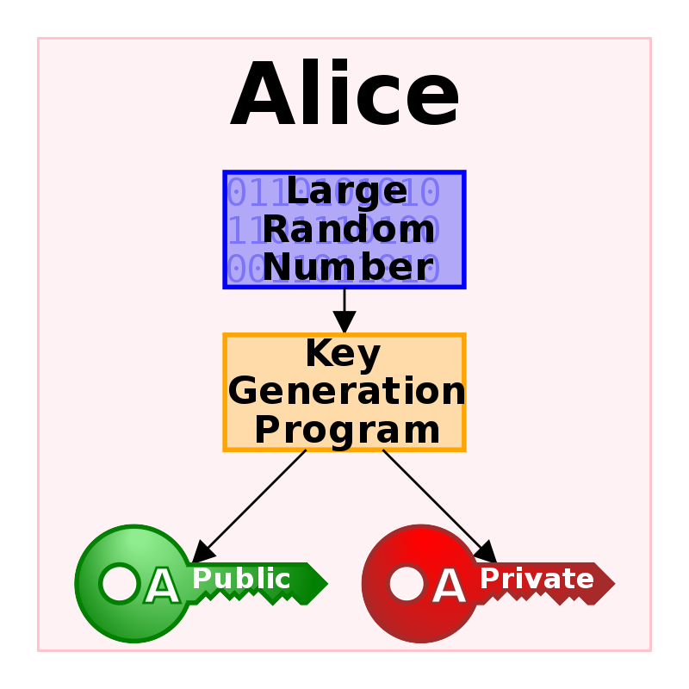
Public-key Cryptography (asymmetric)
Key-pair generated
Public key known to everybody
Private key known only to you
Well known:
RSA (Rivest–Shamir–Adleman)
ECDSA (Elliptical Curve Digital Signature Algorithm)

Slide 4
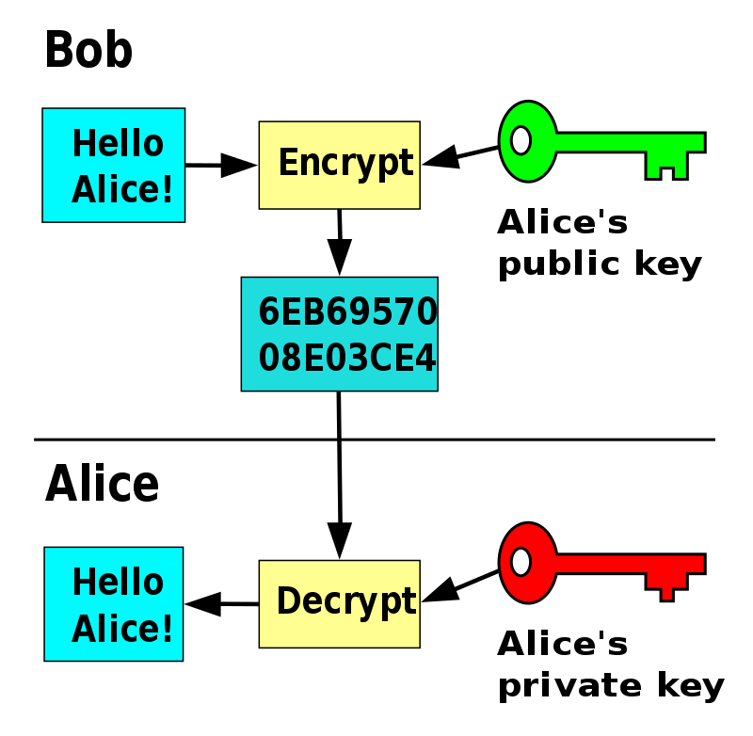
Public-key Cryptography - Secret Messages
Bob wants to send secret message to Alice
Bob encrypts message
ciphertext = Alice_pub_key( plaintext )
Bob send ciphertext to Alice
Alice decrypts message
plaintext = Alice_priv_key( ciphertext )
Usefulness in Blockchain
not generally useful in Bitcoin and Ethereum
keeping transactions secret defeats the purpose
useful for some other Blockchains and niche use cases (e.g. healthcare medical records)

Slide 5
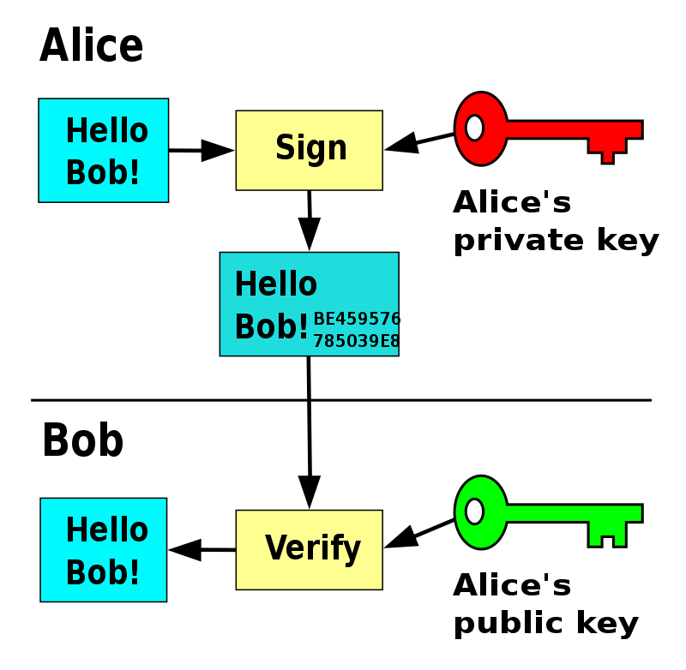
Public-Key Cryptography - Digital Signatures
Bob wants to know the message is actually from Alice
Alice signs with private key
signature = Alice_priv_key(plaintext)
Alice sends message (plaintext) AND signature (ciphertext) to Bob
Bob decrypts signature with public key
validation = Alice_pub_key(signature)
If they match, then message is from Alice
is_valid = message == validation

Slide 6
Public-Key Cryptography - Digital Signatures
Authentication (message origin)
Bob knows message is indeed from Alice
only Alice’s public key could decrypt the signature
Non-repudiation
Alice cannot deny the message is from her
Message Integrity
Bob knows message contents unchanged
if message was changed, the signature will not match the message

Slide 7
Public-Key Cryptography (example)
What’s the prime factorization of 8,018,009?
hard to calculate
basically have to try a bunch of combinations of prime numbers (brute force)
Notes:
2003 * 4003 = 8018009

Slide 8
Public-Key Cryptography (example)
What’s the prime factorization of 8,018,009 given that one of the primes is 2,003?
easy to calculate
8,018,009 / 2,003 = 4,003
4,003 is prime
therefore prime factorization of 8,018,009 is 4,003 and 2,003
Called trapdoor function
difficult to inverse function unless you have a piece of secret information
can use secret info to make computation trivial
Prime factorization used by RSA algorithm
Not used by Bitcoin or Ethereum

Slide 9
Elliptic Curve Cryptography (ECC)
Key-pair algorithm used by Bitcoin and Ethereum
uses the exact same elliptic curve, called secp256k1 (established by SECG)
Based on discrete logarithm problem
Step 1: generate random 256 bit number to get private key
e.g. run a stream of random numbers through Keccak-256 hash function
true random is a problem, have to rely on pseudo-random (good enough in practice)
NIST / Keccak controversy: Dual_EC_DRBG random-number generator standard weakened by influence of NSA, effectively placing a backdoor (allegedly)
2^56 is roughly 10^77, compared with estimated number of atoms in visible universe, 10^80
looks like: f8f8a2f43c8376ccb0871305060d7b27b0554d2cc72bccf41b2705608452f315
Step 2: use private key to find a point on an elliptic curve
easy to find
given point, infeasible to go back and find private key
two numbers: x-coordinate and y-coordinate
Source: https://www.secg.org/sec2-v2.pdf

Slide 10
Elliptic Curve Cryptography
K = k * G
K (upper): public key
k (lower): private key
G: generator point (same for all Ethereum users)
*: elliptic curve “multiplication” (different from ordinary multiplication)
A starting point, G, multiplied by an integer, k, to produce another integer, K
k = K / G
the reverse operation to get private key
elliptic curve “division” (not really, no such thing)
known as finding the discrete algorithm
as difficult as trying all possible values of k (a brute-force search that will likely take more time than this universe will allow for)

Slide 11
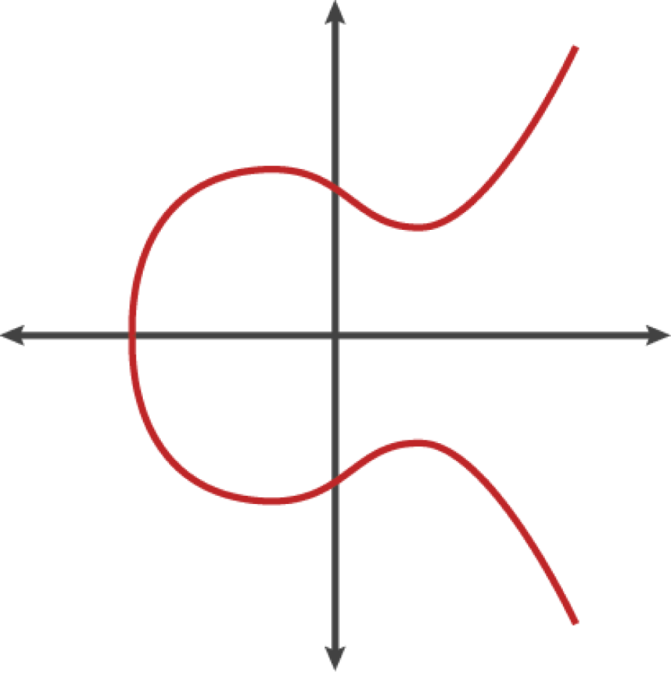
Elliptic Curve Cryptography
Elliptic curve general form:
y^2 = x^3 + ax + b
Key feature: symmetric about x-axis

Slide 12
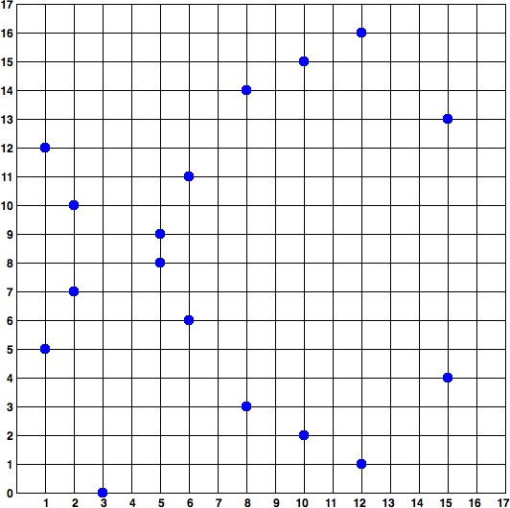
Elliptic Curve Cryptography
Actually discrete version
y^2 mod p = x^3 + 7 mod p
mod p: modulo prime number p
curve defined over finite field of prime order p
﻿p = 2^256 - 2^32 - 2^9 - 2^8 - 2^7 - 2^6 - 2^4 - 1
p is a very large prime number
math is identical to elliptic curves over real numbers
image to right is small finite field of prime order 17
Source: https://www.secg.org/sec2-v2.pdf

Slide 13
Elliptic Curve Cryptography
secp256k1 is a huge grid with a lot more dots
A point, Q, on secp256k1:
Q = (
49790390825249384486033144355916864607616083520101638681403973749255924539515 ,
59574132161899900045862086493921015780032175291755807399284007721050341297360
)

Slide 14
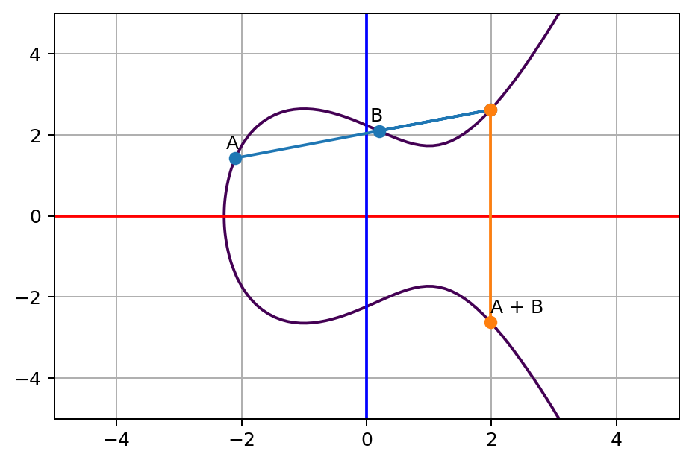
Elliptic Curve Cryptography
Elliptic curve addition: A + B
Draw line through points A and B
If line passes third point on curve, reflect across x-axis to get A + B
Line will not pass through any more points
If line only passes two points, then A + B = 0
If A and B have same x, different y, then line will point to infinity
In this case: A + B = B

Slide 15
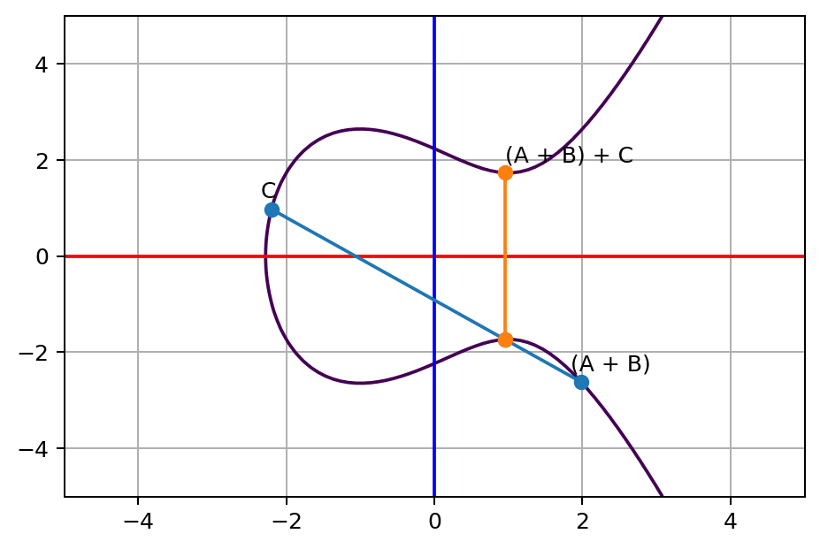
Elliptic Curve Cryptography
Repeat process for every new point
New point C
Find intersection of (A + B) and C
Reflect across x-axis
Get (A + B) + C

Slide 16
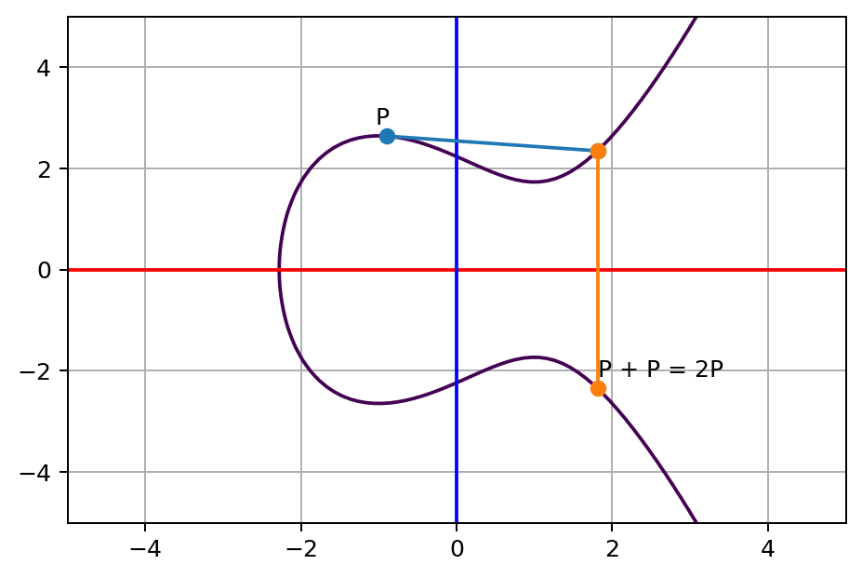
Elliptic Curve Cryptography
What if we add a point to itself?
P and P gets a tangent line intersecting curve at second point
Reflect to get P + P
P + P = 2P
Now we have multiplication

Slide 17
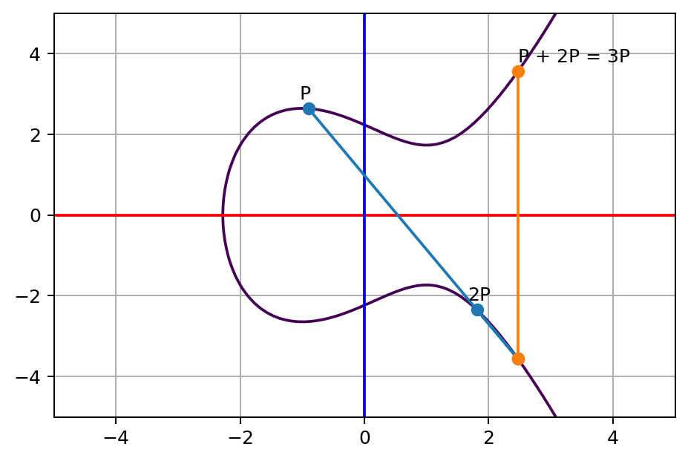
Elliptic Curve Cryptography
Repeat process for 3P

Slide 18
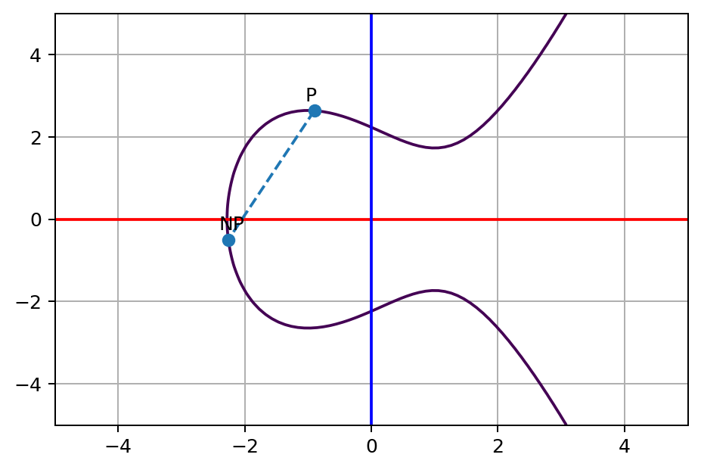
Elliptic Curve Cryptography
Do this N times for NP
Given a starting point and N, the point NP is easy to find
However...given P and NP, can you find N?

Slide 19
Elliptic Curve Cryptography
For image to the right:
Working forwards, start with P and multiply 13 to get NP
brute force
easy for this toy example
hard in general (too much time)
In general, N = log_P( NP )
hence, discrete logarithm problem

Slide 20
Elliptic Curve Cryptography
For secp256k1:
We multiply P by an N of size 2^56, where N is randomly generated
N = log_P( NP ) is computationally infeasible
K = k * G
NP = K, our public key
P = G, our generator
N = k, our private key

Slide 21
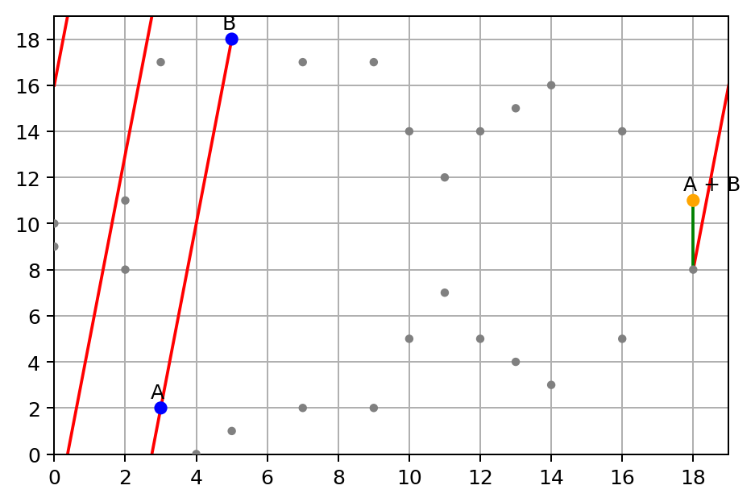
Elliptic Curve Cryptography
Remember, in reality this is occurring on a discrete curve

Slide 22
Elliptic Curve Cryptography
K = f8f8a2f43c8376ccb0871305060d7b27b0554d2cc72bccf41b2705608452f315 * G
k * G = ( 6e145ccef1033dea239875dd00dfb4fee6e3348b84985c92f103444683bae07b ,
83b5c38e5e2b0c8529d7fa3f64d46daa1ece2d9ac14cab9477d042c84c32ccd0 )
Ethereum public keys are 130 hex characters (65 bytes) according to SEC1, with prefix 0x04
K = 04 || x-coord || y-coord
K = 046e145ccef1033dea239875dd00dfb4fee6e3348b84985c92f103444683bae07b83b5c38e5e2b0c8529d7fa3f64d46daa1ece2d9ac14cab9477d042c84c32ccd0

Slide 23
Addresses
Bitcoin
Uses 3 main address formats
P2PKH which begin with the number 1, eg: 1BvBMSEYstWetqTFn5Au4m4GFg7xJaNVN2.
P2SH type starting with the number 3, eg: 3J98t1WpEZ73CNmQviecrnyiWrnqRhWNLy.
Bech32 type starting with bc1, eg: bc1qar0srrr7xfkvy5l643lydnw9re59gtzzwf5mdq.
Address formats have to do with Bitcoin scripts
details outside of scope for this discussion
P2PKH most “straightforward” type of transaction: address represents owner of key-pair
P2SH for things like multi-sig
34 Base58 characters encoded in Base58Check Encoding

Slide 24
Addresses
Bitcoin - Base58
62 characters: 1-9, 0, A-Z, a-z
0 goes after 9, not before 0
58 characters by removing easy to mix-up chars, omitting uppercase i, lower case L, 0, and uppercase O
1234567890ABCDEFGHIJKLMNOPQRSTUVWXYZabcdefghijklmnopqrstuvwxyz

Slide 25
Addresses
Bitcoin - Base58Check Encoding
Base58Check Encoding includes a checksum to data for built-in error checking
used for several purposes in Bitcoin, including addresses
Checksum is additional 4 bytes concatenated to data being encoded
Derived from hash of encoded data
helps detect and prevent transcription and typing errors

Slide 26
Addresses
Bitcoin - Base58Check Encoding
Step 1: prefix version byte to data
identifies type of data (0x00 in hex, 1 in Base58, for a bitcoin address)
prefix to data
Step 2: SHA256 squared of data with prefix
hash = SHA256( SHA256( version_prefix || data ))
Step 3: Take only first 4 bytes of 32 byte hash
checksum = first_4_bytes( hash )
this serves as error-checking code
appended to data
Step 4: Base58 encode the resulting data
Base58( version_prefix || data || checksum )

Slide 27
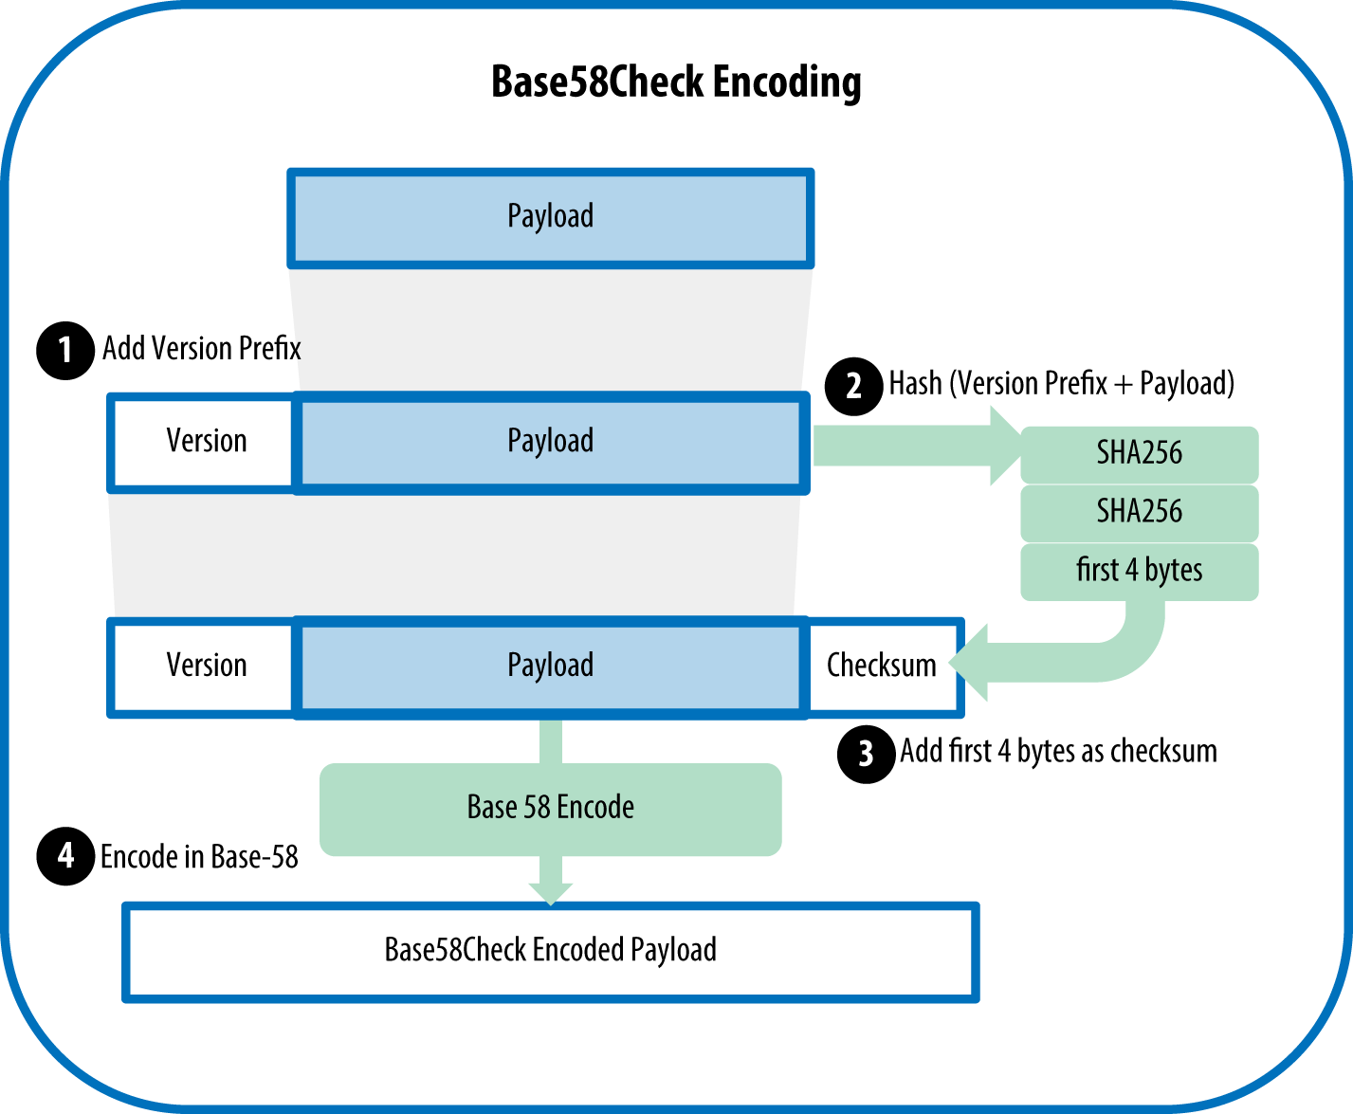
Addresses
Bitcoin - Base58Check Encoding
Recall prefix of 0x00 in Base58 is 1, which represents “P2PKH”

Slide 28
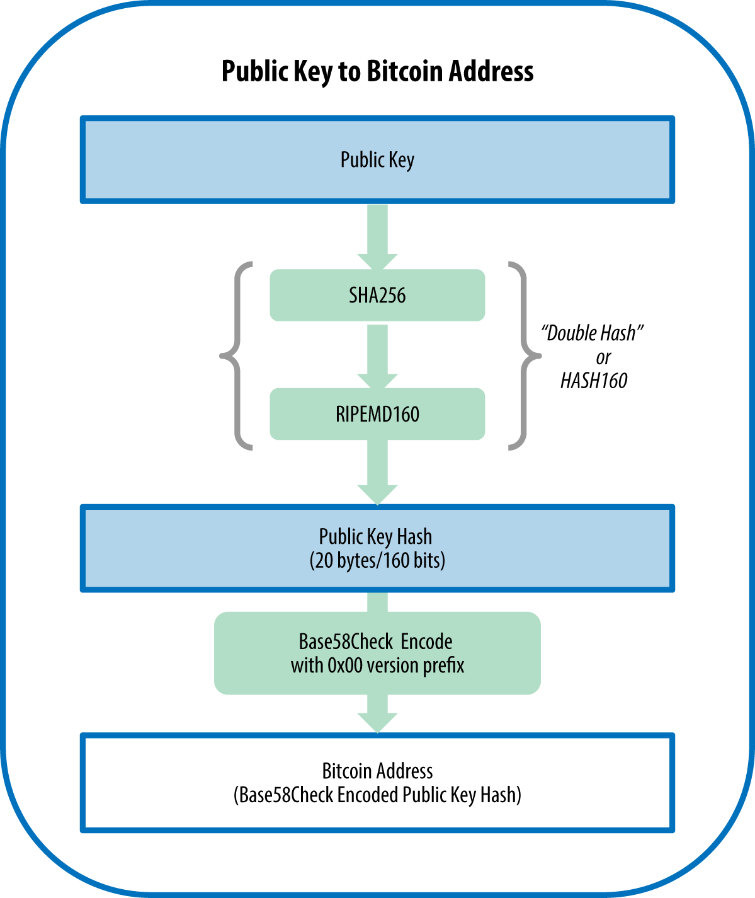
Addresses
Bitcoin - Generating the Address
Step 1: run the public key through SHA256 to get a hash
Step 2: run through RIPEMD160 to get another hash
produces a 160-bit (20-byte) number
RIPEMD: RACE Integrity Primitives Evaluation Message Digest
Step 3: Base58Check Encode the hash

Slide 29
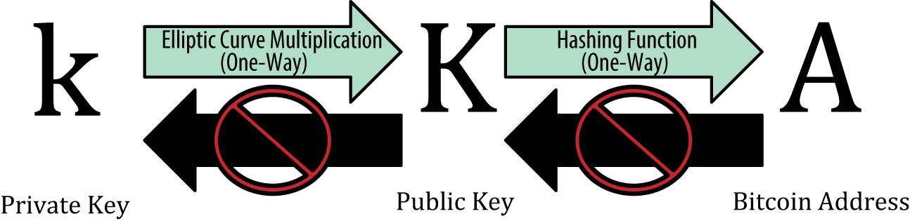
Addresses
Bitcoin - Generating the Address
Is it practically possible to derive the private key from the address?
Given infinite time and resources, sure, otherwise no… not even close

Slide 30
Addresses
Ethereum
Addresses are unique identifiers
derived from public keys (or contracts)
using Keccak-256 hash function
Keccak256( K )
public key NOT prefixed with 04 when deriving address
Then only use last 20 bytes (least significant)
0x denotes hexadecimal
Keccak256(K) = 2a5bc342ed616b5ba5732269001d3f1ef827552ae1114027bd3ecf1f086ba0f9
Address = 0x001d3f1ef827552ae1114027bd3ecf1f086ba0f9

Slide 31
Addresses
Ethereum
What about Base58Check Encoding?
No special encoding, just hex
No checksum
Rationale: Ethereum addresses would eventually be hidden behind abstractions (such as name services) at higher layers of the system and that checksums should be included at higher layers if necessary
Reality: Higher levels developed too slowly
led to problems early on
loss of funds due to mistyped addresses and input validation errors
alternative encodings adopted very slowly by wallet developers
but wallets are a story for another time...

Slide 32
Sources
Mastering Ethereum Book
Mastering Bitcoin Book
Elliptic Curve Cryptography Explained
Wikipedia: Public-key cryptography
Bitcoin Wiki: Bitcoin addresses
Standards for Efficient Cryptography (SECG) Recommended Elliptic Curve Domain Parameters [SECP256K1 on page 9, section 2.4.1]

